Slide 1
Determining Rate of Violent Crime by Public Institutions
In NYC
Folly Gbegnon, Wade Keeler,
Shareen Rahmathulla, Hannah Shelton

Slide 2
Agenda
Purpose
Research Questions
Data Acquisition and Clean-up
Data Interpretation
Approach
Results/Conclusions
Next Steps

Slide 3
Part 1
Purpose, Research Questions

Slide 4

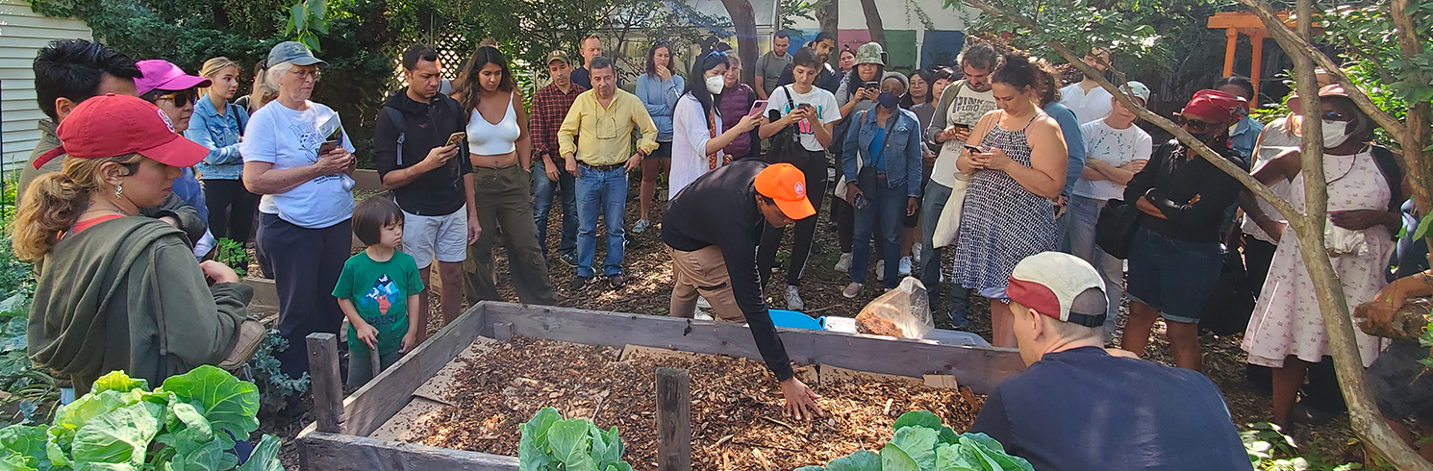
Purpose
In 2023, New York City saw changes in access to public libraries and parks. While funding for library materials and programs was reduced, parks were enhanced with better bike trails and community gardens.

Slide 5
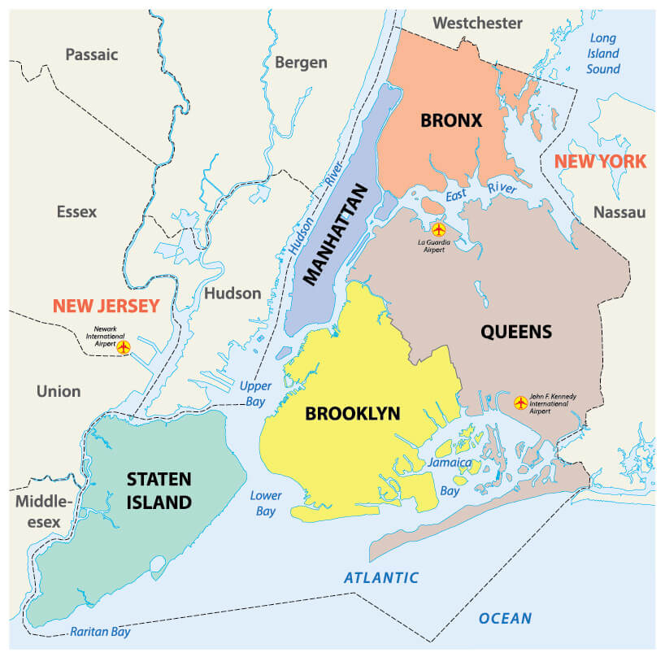
Introduction
Understand the rate of violent crimes (defined as rape, murder/manslaughter, and robbery) in New York City, for the year 2023, and the proximity to public institutions, specifically public libraries and parks.

Slide 6
Research Questions
Does proximity to public areas affect where violent crimes are committed?
If there are cases where crime rates are higher, in which public area and borough?
In which public areas are rape, robbery, and murder/manslaughter more likely to occur?

Slide 7
Part 2
Data Acquisition, Data Clean-Up,
and Data Interpretation

Slide 8
Data Acquisition
Data used for the project came from these sources:
https://opendata.cityofnewyork.us/data - this source was used to obtain data on the types of crimes studied.
https://capitalplanning.nyc.gov/ - this source was used to obtain data on public facilities.
https://api.census.gov/data/2022/acs/acs1/spp - this source was used to obtain demographic data.

Slide 9
Data Clean-Up
Crime data and public facility data was merged based on Latitude and Longitude of the locations of the occurrences of violent crimes and the location of the facility.
Crime and public facility data was mapped using Latitude and Longitude in order to find the proximity of a violent crime occurrence in relation to the site of the public facility.

Slide 10
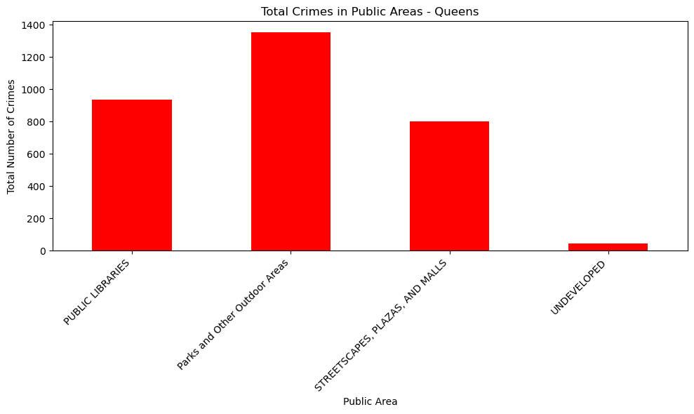
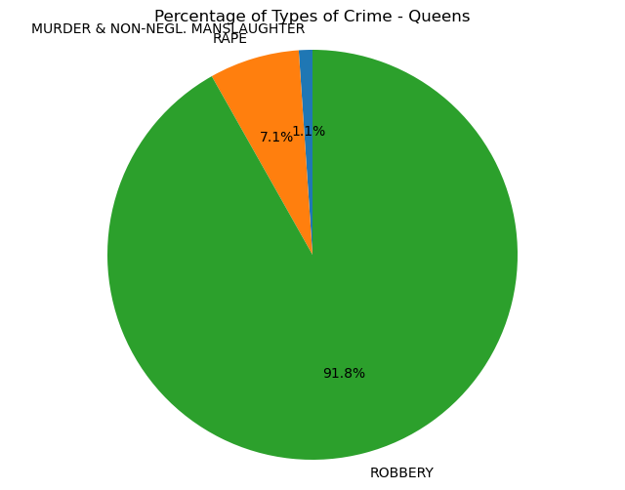
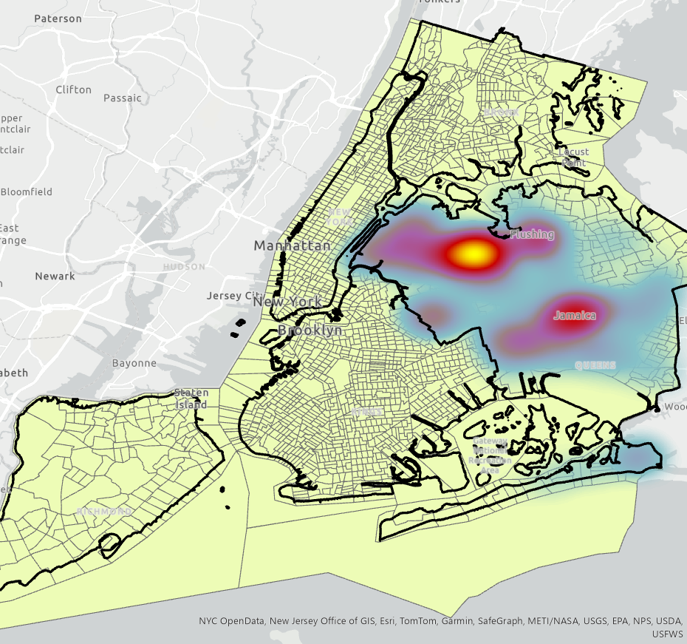
Data Interpretation
The charts visualized from the data were bar charts depicting the total number of violent crimes that occured at the type of public facility, pie charts that depicted the percentage of the type of violent crimes that occured at the type of the public facility, and heat maps that depicted the density of crimes based on the New York City borough and New York City as a whole.

Slide 11
Part 3
Approach

Slide 12
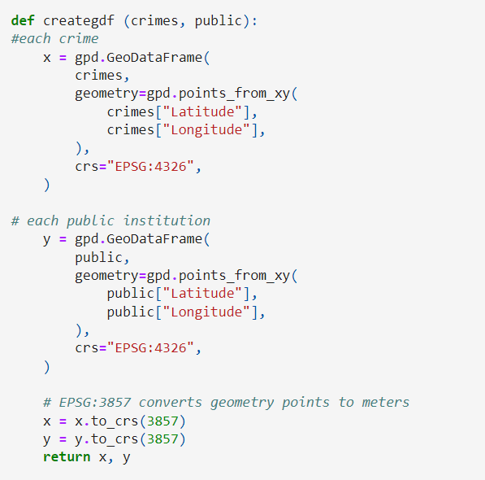
Converting To GeoDataframe for Mapping

Slide 13
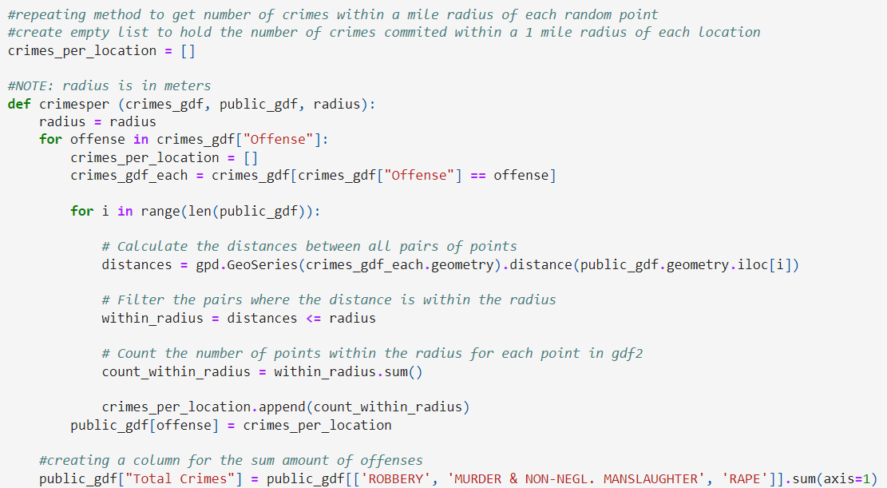
Counting Crimes Within a Radius

Slide 14
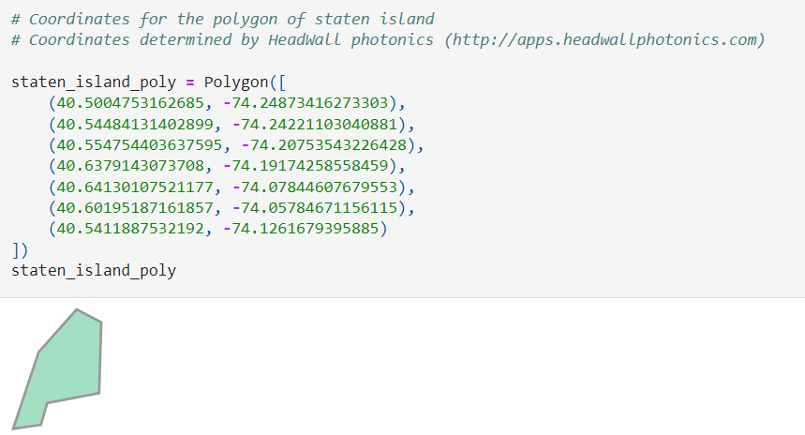
Collecting Random Sample Data

Slide 15
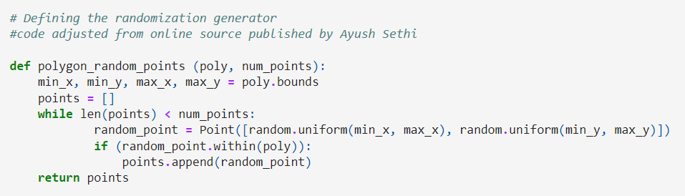
Collecting Random Sample Data

Slide 16
What Significance Test to Use?
Z-Test
T-Test
Sample size is over 30
Variance is known
Sample size is under 30
Variance is unknown

Slide 17
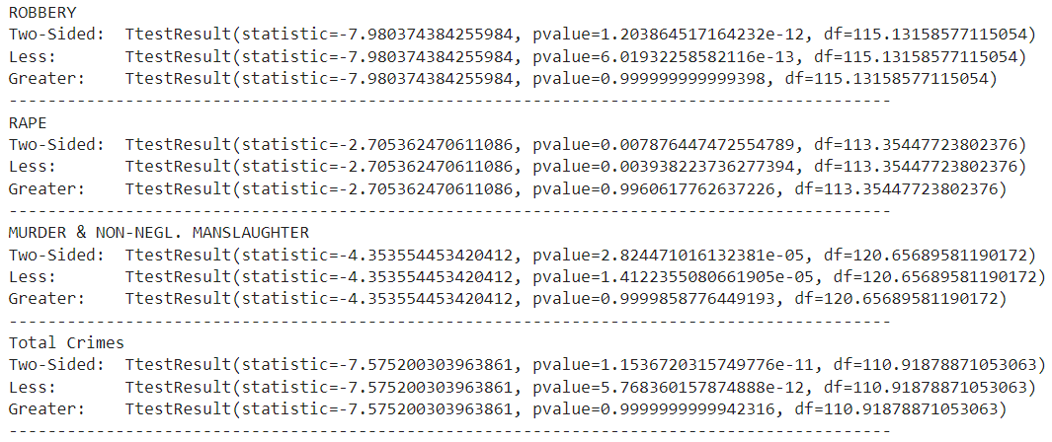
T-Test Results

Slide 18
Part 4
Results/Conclusion

Slide 19
T-Test Results

Slide 20
Data Interpretation
The types of violent crimes that were studied were rape, robbery, and murder (non-neligent homicide).
Totals across all boroughs of New York City were 1102 occurrences of rape, 33730 occurrences of robbery, and 362 occurences of murder (non-negligent homicide) within one mile of a public space.
The borough with the smallest total of all violent occurrences was Staten Island with 366 total crimes.
The borough with the largest total of all violent occurrences was the Bronx with 5347 total crimes.
Heat Density Maps for each borough are depicted for the purpose of public initiatives or increased policing in those areas.
Parks and Outdoor Areas have the highest rates of violent occurrences.

Slide 21
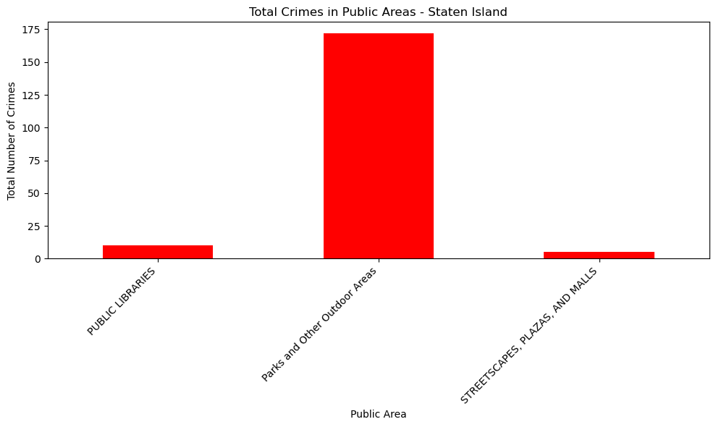

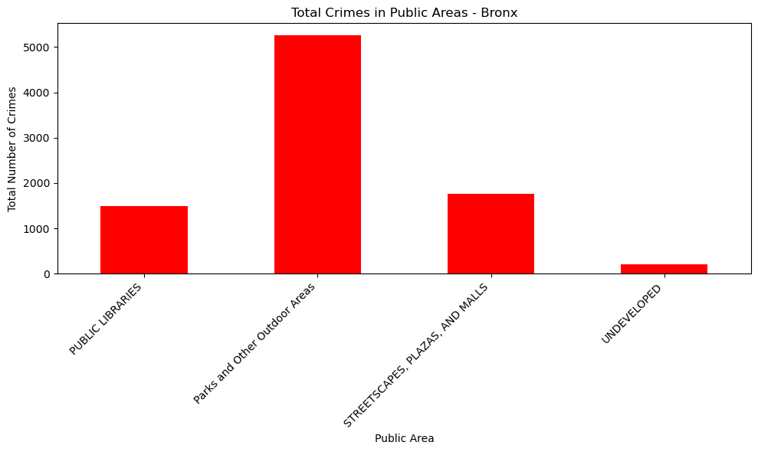
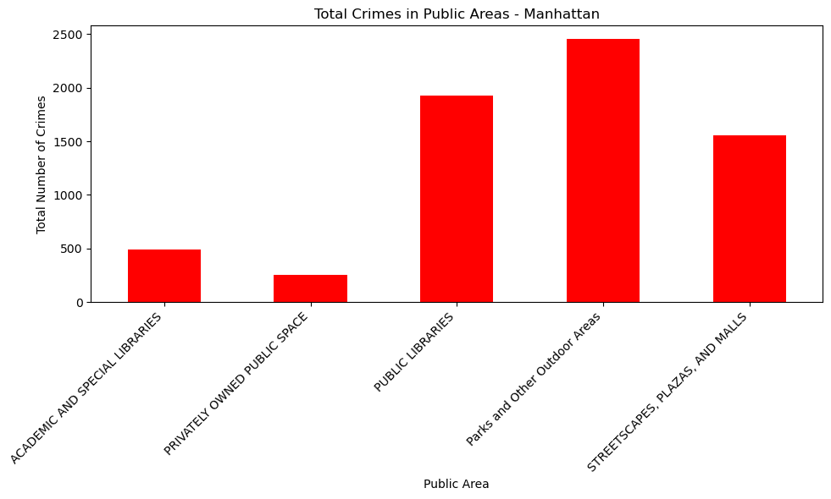
Total Count of Crimes in a One-Mile Proximity of Public Areas
Staten Island
Brooklyn
Bronx
Queens
Manhattan
Academic Libraries
Privately Owned
Public Spaces
Public Libraries
Parks and Other
Outdoor Areas
Malls, Plazas and
Streetscapes
Undeveloped

Slide 22
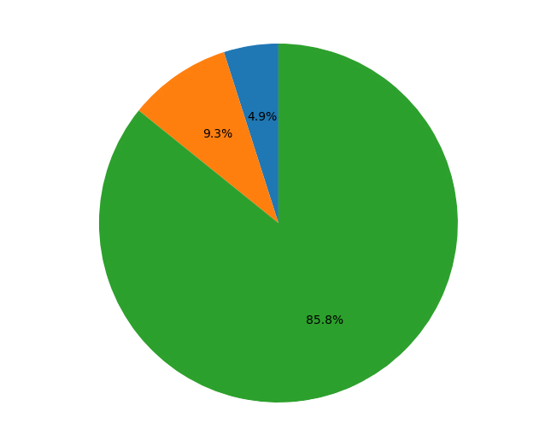

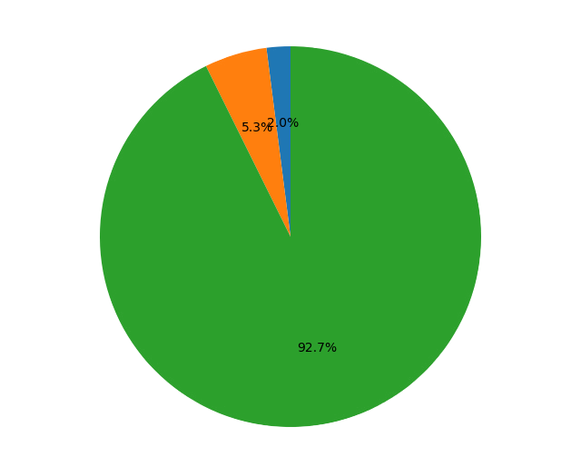

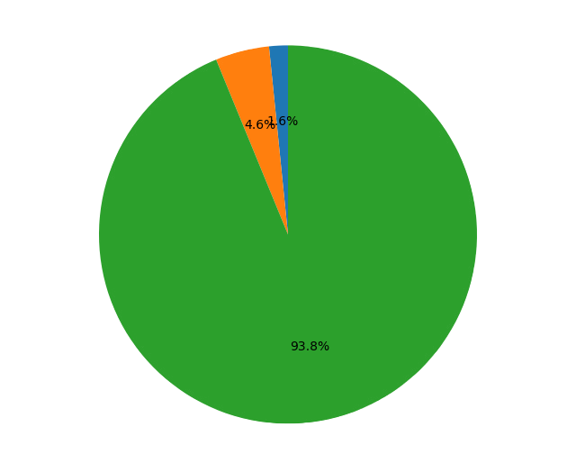
Percentage of Types of Crime
Staten Island
Brooklyn
Bronx
Queens
Manhattan
Robbery
Rape
Murder

Slide 23

Next Steps
This analysis aims to provide city officials, policing agencies, and citizens of NYC with the information necessary to evaluate and recommend changes to current strategies, policies and funding for programs within public libraries and parks.

Slide 24
Q & A

